Slide 1
CS2030 Tutorial 1
By Jeremy Lim

Slide 2

Who am I
Jeremy Lim, jeremylim@u.nus.edu
Year 2 CS (AI & Software E)
3rd time CS2030 TA
11+ years programming
Friday 2-5pm Tutorials (Attend any you want)

Slide 3
Who am I
I won’t remember your name
I like slides
I like to put what I want to say in the slides (for your self-reference) (also because I can’t remember)

Slide 4
Why attend (my) tutorials
2% Attendance mark + 3% Participation
Become a better programmer
Extra material (will help you in labs & later mods e.g. CS2103)
Key concepts from lectures in a simpler way
Exam revision

Slide 5
How to OOP

Slide 6
First:
Throw away your CS1010 / CS1101S approaches
Trial and error will NOT work in CS2030

Slide 7
Aims of OOP
Easy to add new features
Break code into more manageable chunks
(more on this during next week’s tutorial)
Increase reusability

Slide 8
Scenario
Want to simulate plants and animals
They can grow bigger, die, or multiply (all plants and animals are asexual)

Slide 9
Identify Nouns
Want to simulate plants and animals
They can grow bigger, die, or multiply (all plants and animals are asexual)
These are candidates for classes

Slide 10
Identify verbs or functionality
Want to simulate plants and animals
They can grow bigger, die, or multiply (all plants and animals are asexual)
These are candidates for methods

Slide 11
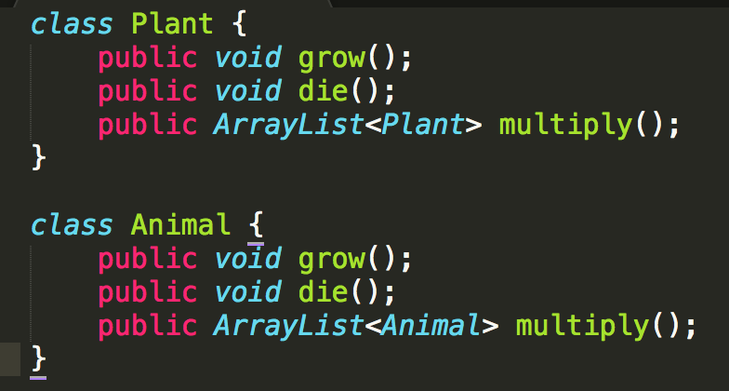
Create Classes

Slide 12
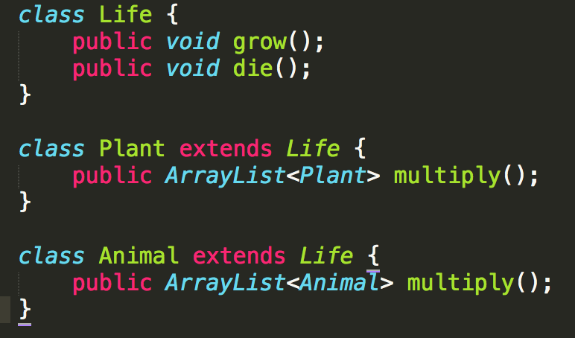
Combine common elements
D.R.Y. (Don’t Repeat Yourself)

Slide 13
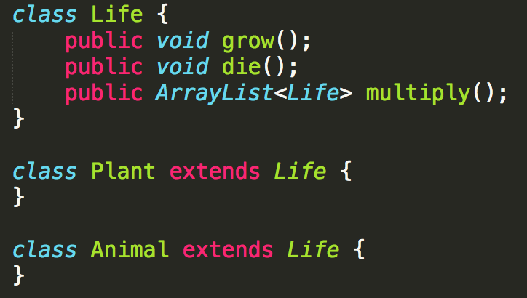
We can do better
Use inheritance to make things easier

Slide 14
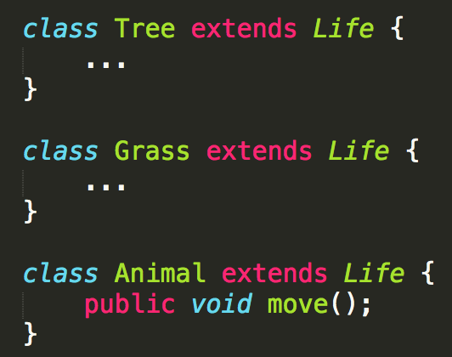
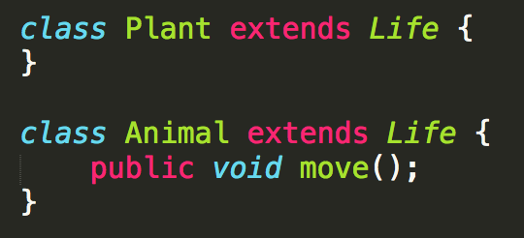
On “empty” classes
It is okay to have classes that have no difference from their parents
vs
Plan ahead, do work now to avoid more work later
╳
✔
Notes:
Example: Want to add plant-only methods in the future

Slide 15
Class Diagram
Life
Animal
Plant

Slide 16
Class Diagram
OOP is like creating logical groups of variables and methods
Life
Animal
Plant

Slide 17
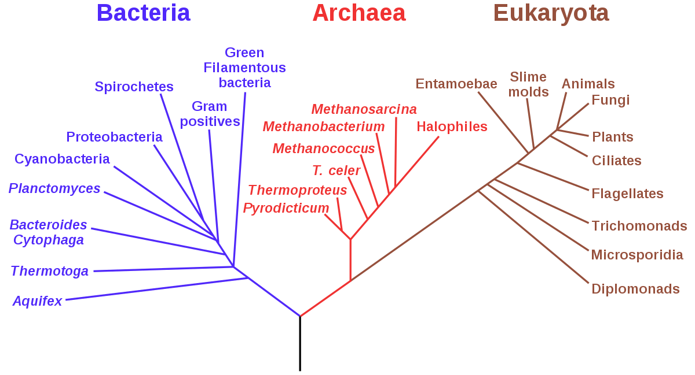

Slide 18
New Feature
Want to simulate immortal life (i.e. gods, i.e. )
How to model?
https://www.reddit.com/r/onetruegod/

Slide 19
Class Diagram
Maybe?
Life
Animal
Plant

Slide 20
Class Diagram
Maybe?
Life
ImmortalLife
Animal
Plant

Slide 21
Class Diagram
Life
Actually…
MortalLife
Animal
Plant

Slide 22
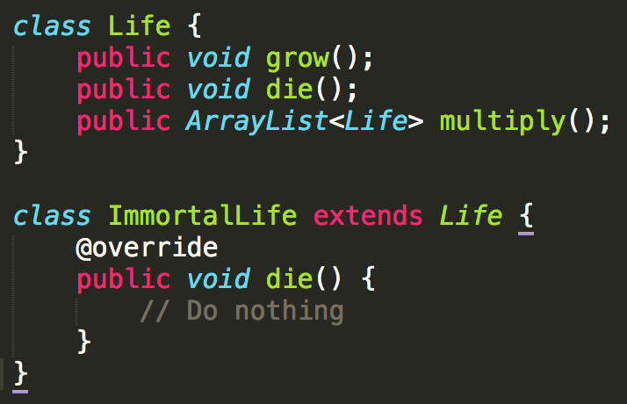
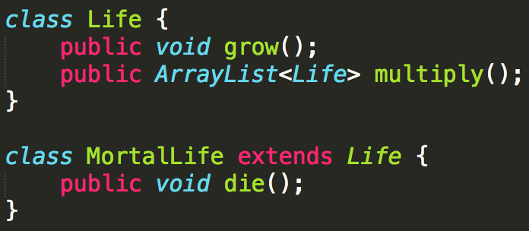
Why?
\
vs
“Child” classes must have the same functionality as their parents
They can have more functions or do things differently, but the method must still do as described

Slide 23
I catch no ball??? / TL;DR / Summary
Classes are groupings of methods and variables that should be together
Inheritance allows child classes to adopt functionality of ancestors
Parent classes are less specialized / Child classes are more specialized
Easily identify classes by looking for nouns, and methods are actions or verbs

Slide 24
You should now know…
How classes are related to each other
Plan your classes before coding
Don’t rush to code
Seriously, you will regret it if you do it like you’re in CS1101S

Slide 25
Next week’s extra material
Interfaces and Abstract Classes
Decoding terrible code, i.e. why you should always plan first

Slide 26
The Actual Tutorial

Slide 27
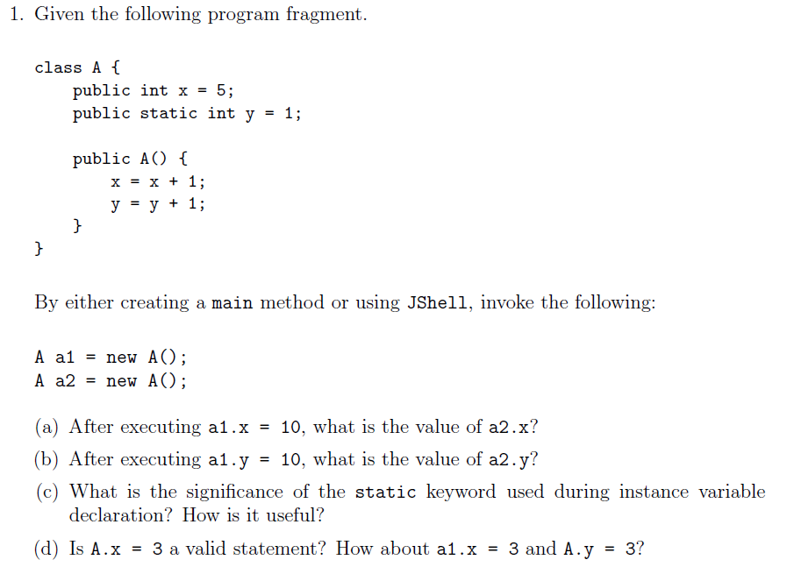
Q1

Slide 28
Q1
= 6 after initialization
6
10

Slide 29
Q1
= 6 after initialization
6
10
BAD

Slide 30
Q1
= 6 after initialization
y = 2 after initialization
y = 3 after initialization
6
10
BAD

Slide 31
Q1
Significance:
static variables are shared among all instances of the class
Changing a static variable in one instance changes it for all instances
Usefulness:
Example: Keep a running ID
Don’t have to loop through all instances to change a variable Example: Instances of a class upload data to the same server. A static server variable allows the server to be changed for all instances at once if the original server goes down

Slide 32
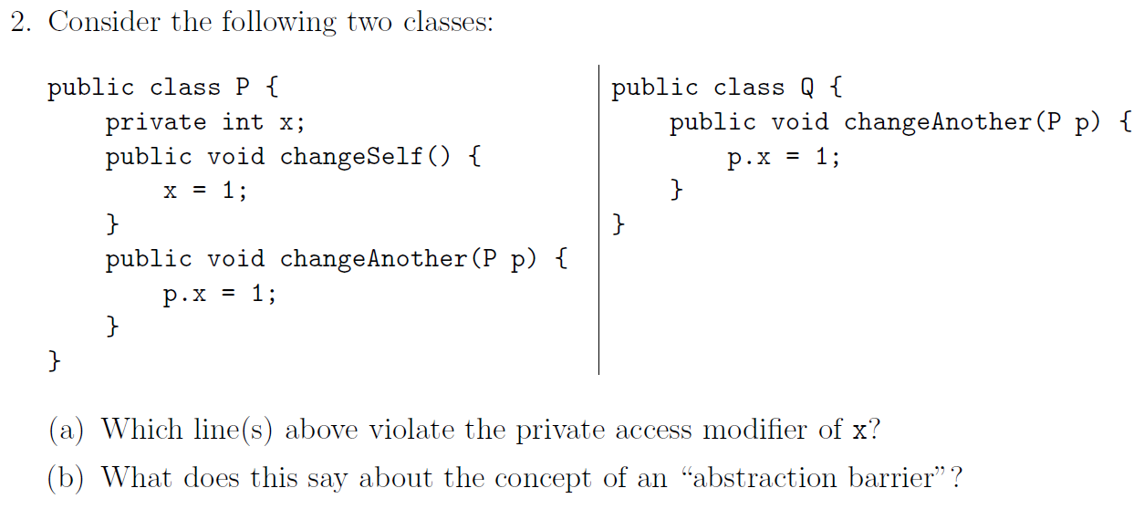
Q2

Slide 33
Q2

Slide 34
Q2
The abstraction barrier sits between the implementer (P) and the user (user of the implementer, Q)

Slide 35
Q2
Why is this okay?
The abstraction barrier sits between the implementer (P) and the user (user of the implementer, Q)

Slide 36
Q2
Why is this okay?
Within the same class as P.x
The abstraction barrier sits between the implementer (P) and the user (user of the implementer, Q)

Slide 37
Access Modifier
Note: “Same Class” != “Same File”
Access Modifier \ Accessing Class | All Classes | Same Package | Child classes | Same Class
Public | ✔️ | ✔️ | ✔️ | ✔️
Default (Package Protected) | ❌ | ✔️ | ✔️ | ✔️
Protected | ❌ | ❌ | ✔️ | ✔️
Private | ❌ | ❌ | ❌ | ✔️

Slide 38
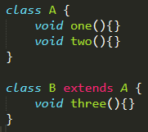
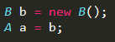
How polymorphism works
A’s Methods
one
two
A’s Impl.
one
two
B’s Methods
one
two
three
B’s Impl.
three
Notes:
Since B does not override one and two, it will use A’s implementation.

Slide 39
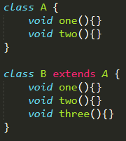
How polymorphism works
A’s Methods
one
two
A’s Impl.
one
two
B’s Methods
one
two
three
B’s Impl.
one
two
three
Notes:
Since B overrides one and two, it will use its own implementation.

Slide 40
How polymorphism works
A’s Methods
one
two
A’s Impl.
one
two
B’s Methods
one
two
three
B’s Impl.
one
two
three

Slide 41
How polymorphism works
A’s Methods
one
two
A’s Impl.
one
two
B’s Methods
one
two
three
B’s Impl.
one
two
three
Notes:
Equivalent to A a = new B();
Since a is stored as type A but initialised as type B, it has A’s methods but B’s implementation.
Note that three is inaccessible as A does not have it.

Slide 42
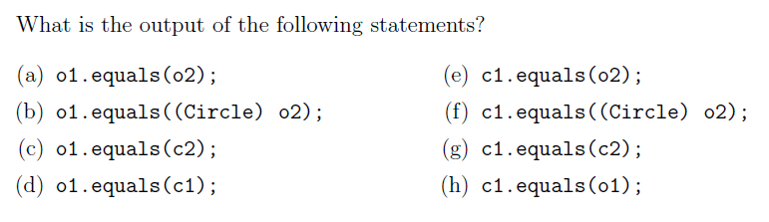
Q3
It depends.
F/F/F/T/F/F/F/T if Point does not implement .equals()
T/T/T/T/T/T/T/T if Point implements .equals()

Slide 43
Q3
Object’s Methods
equals(Object)
Object’s Impl.
equals(Object)
Circle’s Methods
equals(Object)
equals(Circle)
Circle’s Impl.
equals(Object)
equals(Circle)
Notes:
Equivalent to A a = new B();
Since a is stored as type A but initialised as type B, it has A’s methods but B’s implementation.
Note that three is inaccessible as A does not have it.

Slide 44
Q3
Object’s Methods
equals(Object)
Object’s Impl.
equals(Object)
No equals(Circle) in Object
so fallback to equals(Object)
(Circle inherits from Object)
Circle’s Methods
equals(Object)
equals(Circle)
Circle’s Impl.
equals(Object)
equals(Circle)
Notes:
Equivalent to A a = new B();
Since a is stored as type A but initialised as type B, it has A’s methods but B’s implementation.
Note that three is inaccessible as A does not have it.

Slide 45
Q3
Object’s Methods
equals(Object)
Object’s Impl.
equals(Object)
Circle’s Methods
equals(Object)
equals(Circle)
Circle’s Impl.
equals(Object)
equals(Circle)
Notes:
Equivalent to A a = new B();
Since a is stored as type A but initialised as type B, it has A’s methods but B’s implementation.
Note that three is inaccessible as A does not have it.

Slide 46
Q3
Object’s Methods
equals(Object)
Object’s Impl.
equals(Object)
Circle’s Methods
equals(Object)
equals(Circle)
Circle’s Impl.
equals(Object)
equals(Circle)
Notes:
Equivalent to A a = new B();
Since a is stored as type A but initialised as type B, it has A’s methods but B’s implementation.
Note that three is inaccessible as A does not have it.

Slide 47
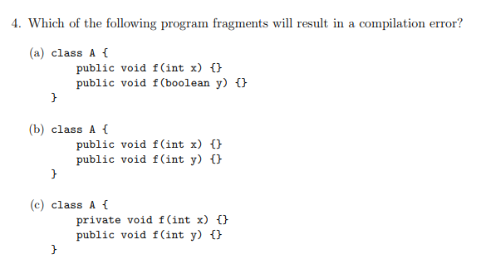
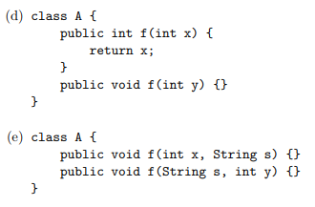
Q4

Slide 48
Q4
Considered: Name, return type, input parameters (type, number, order)
Error Can’t decide what to return
Error f(int) = f(int)
Error Can’t decide which to use

Slide 49
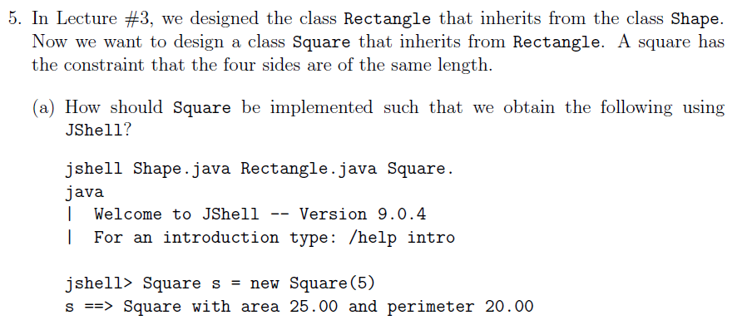
Q5

Slide 50
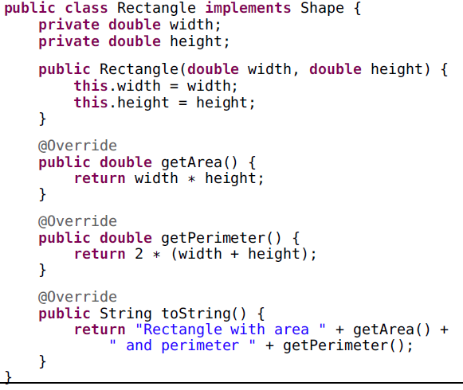
Q5
(From lecture slides)

Slide 51
Q5
One way to do it
Square extends Rectangle
width

Slide 52
Q5
Another way to do it
Square extends Rectangle
width
4
Notes:
More “correct” way to implement in the OO-sense

Slide 53
Q5

Slide 54
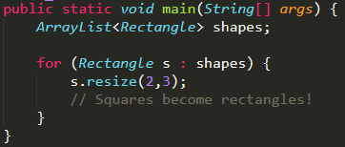
Q5
If Square extends Rectangle
Method behaviour should not change.

Slide 55
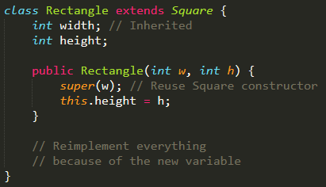
Q5
If Rectangle extends Square
Technically correct, but is almost a totally different class

Slide 56
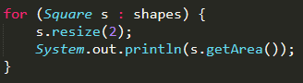
Q5
If Rectangle extends Square
Now squares don’t have a square area!
Answer: Shouldn’t inherit from each other

